Slide 1
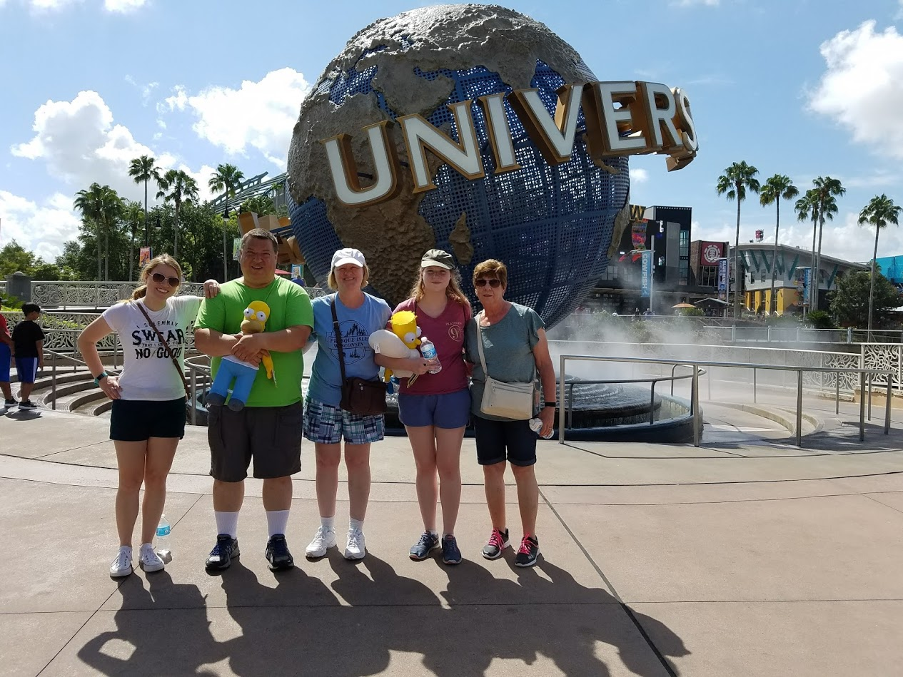
WELCOME TO MRS. MCELHENY’S 4TH GRADE CLASS!
4th Grade * Room 12

Slide 3
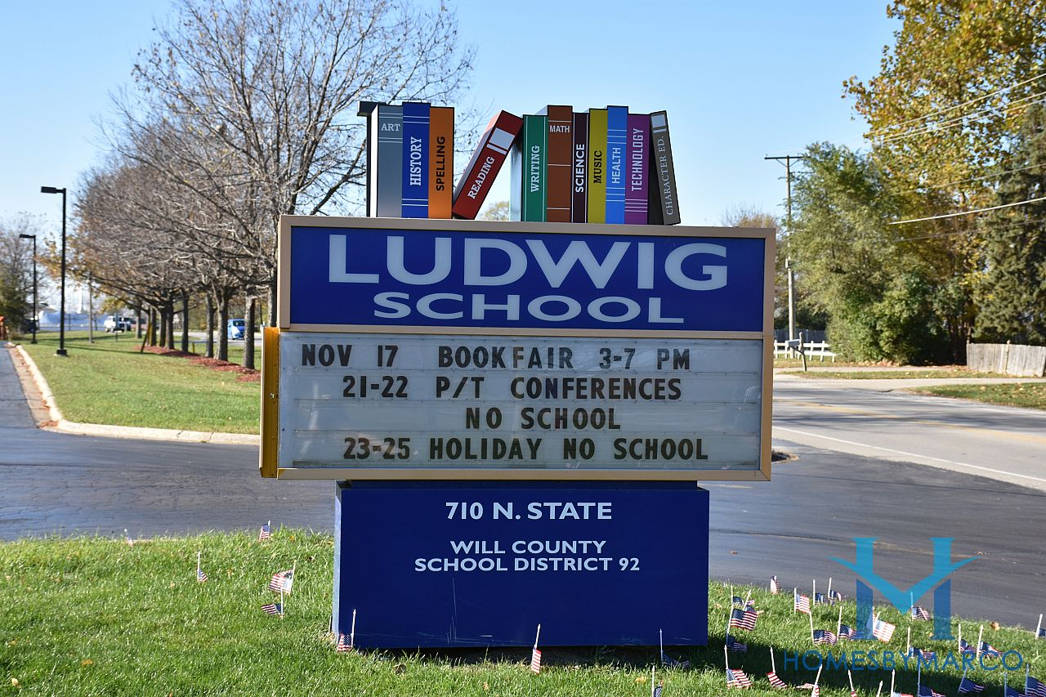
TEACHING HISTORY
20 YEARS TEACHING EXPERIENCE
TWELTH YEAR WORKING IN DISTRICT 92
EIGHTH YEAR TEACHING 4TH GRADE

Slide 4
CONTACT INFORMATION
Mrs. Jennifer McElheny
Email: jmcelheny@d92.org
Phone: 815-838-8020
Website: http://mcelheny.weebly.com/

Slide 5
CURRICULUM
Math: Bridges
~Number Corner
~5 areas: Calendar Collector, Calendar Grid, Computational Fluency, Problem Strings, & Solving Problems
~Common Core aligned, student books, computer games, students assessments
Bridges Math
~Multiplication facts, Area Model, Ratio Table, Fractions,
2 digit Multiplication & Division
~ Components: student books, home connection, digital games, & math notebook

Slide 6
CURRICULUM
Reading/Language Arts
~School Wide- Emphasis on Fiction, Non-fiction, Poetry
~Whole group instruction as well as small group instruction.
~Assessments: FAST, BAS as well as informative and summative.
Spelling
~Words Their Way- A word study program designed to help students strengthen their understanding of words and spelling patterns.
~Words sorts are differentiated based on student skills
~Practice activities are based on sorts to develop solid functional skills.
Writing/Grammar
~Narrative, Informational/Explanatory, & Argumentative

Slide 7
CURRICULUM
Social Studies
~ This year we will be reviewing geography and begin learning about the components of our government.
~The core curriculum of social studies will be learning about the different regions in the United States
Science
~Science Fusion series.
~Some topics covered will be motion, energy, and electricity.

Slide 8
SPECIAL SCHEDULE
P.E. ~ M/T- TH/F ~ 10:15-10:45
Music ~ W/F ~ 9:45-10:15
Media ~ W ~ 9:00-9:45 Day for returning books.
Art ~ T ~ 9:15-9:50
We have lunch at 11:40-12:00 followed by structured play from 12:00-12:20.

Slide 9
CLASSROOM TECHNOLOGY
PROGRAMS/SITES
Prodigy
Spelling City
Quizlet
Mystery Science
Dreambox
Words Their Way
Seesaw
Newsela

Slide 10
HOMEWORK
Book Bingo- Weekly goals as well as quarterly goals.
Spelling Words
Any assignments not completed in class.
Presentations, Writing Assignments, Extra Credit
*Assignments are due on the date given. One day results in the loss of recess to complete the assignment. Work that is not turned in will be recorded as a zero.

Slide 11
BEHAVIOR MANAGEMENT
SCHOOLWIDE
Give Me Five
Wall of Fame – Straight A’s, Perfect Attendance
Golden Tickets
CLASSROOM
Expectations will be discussed and established as a class when school begins.

Slide 12
BEHAVIOR MANAGEMENT
All students start each day Ready to Learn
Verbal Warning
Name moves from Ready to Learn to Think About It on behavior chart in classroom.
Another incident name moves to Teacher’s Choice
When positive choices are made student’s name moves up. Students can move up or down the Behavior Chart throughout the day depending on the choices they make.
When necessary parents will be contacted to discuss student behavior.

Slide 13
LOOSE ENDS
Parent signature on assignment notebook
Class T-shirts
Weekly Folders
Questions?

